Slide 1
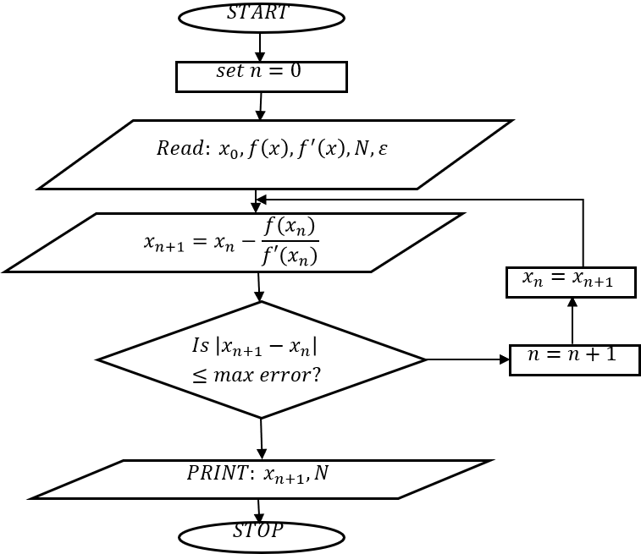
.
FLOW CHART

Slide 2
PSEUDO CODES
‘for loop’
Input: initial guess x0, tolerance tol, max iterations N
Set x = x0
For k = 1 to N
Compute f = 1 - 3*x + 0.5*x*exp(x)
Compute fprime = -3 + 0.5*exp(x) + 0.5*x*exp(x)
Update x_new = x - f/fprime
If |x_new - x| < tol
Stop and output x_new
EndIf
Set x = x_new
EndFor
Output: approximate root

Slide 3
‘while loop’
Input: initial guess x0, tolerance tol, max iterations N
Set x = x0
Set k = 0
While k < N
Compute f = 1 - 3*x + 0.5*x*exp(x)
Compute fprime = -3 + 0.5*exp(x) + 0.5*x*exp(x)
Update x_new = x - f/fprime
If |x_new - x| < tol
Stop and output x_new
EndIf
Set x = x_new
Increment k
EndWhile
Output: approximate root

Slide 4
MATLAB CODES
‘For loop’
% Newton's Method using FOR loop
f = @(x) 1 - 3*x + 0.5*x*exp(x);
fp = @(x) -3 + 0.5*exp(x) + 0.5*x*exp(x);
x0 = 1; % initial guess
tol = 1e-5; % tolerance
N = 50; % max iterations
x = x0;
for k = 1:N
x_new = x - f(x)/fp(x);
if abs(x_new - x) < tol
fprintf('Root found: %.5f after %d iterations\n', x_new, k);
break;
end
x = x_new;
end

Slide 5
‘while loop’
% Newton's Method using WHILE loop
f = @(x) 1 - 3*x + 0.5*x*exp(x);
fp = @(x) -3 + 0.5*exp(x) + 0.5*x*exp(x);
x0 = 1; % initial guess
tol = 1e-5; % tolerance
N = 50; % max iterations
x = x0;
k = 0;
while k < N
x_new = x - f(x)/fp(x);
if abs(x_new - x) < tol
fprintf('Root found: %.5f after %d iterations\n', x_new, k);
break;
end
x = x_new;
k = k + 1;
end

